Slide 1
BIA 810: Health Care Analytics Final Project Presentation
Presented By:
Group 5
Venkata Sandilya Bagavathula
Hardikaben Sanghani
WeiWei Tao
Hinali Maiyani
BIA 810 - Health Care Analytics​ Prof. Sanjiv Koshal

Slide 2

Today’s Agenda
Topics
Presenters
Team Introductions
State the Business Problem
Highlights of Solution
Discussion of the approach and insights gained from the data
Recommendations to the Leaders
Key findings and propose actionable summary
Hinali
WeiWei
Hardika
Sandilya
2

Slide 3

Analyzing Competitive Dynamics in the Injectable Anesthesia Market
3

Slide 4
Executive Summary
Problem Statement:
The project examines why Midoride is struggling to outperform the older product, Ketotrom, and its effectiveness against competitors Fentirate and Profativ in the injectable anesthesia market. The objective is to strategize for boosting Midoride's market share.
Business Solution: Increase Midoride's market share by leveraging Ketotrom's healthcare provider network, enhancing targeted marketing and educational efforts, and adapting strategies based on regional market dynamics and specific healthcare specialties.
Business Impact: Reverse market share decline and boost Midoride's presence.
Improved competitive positioning leading to increased revenue and profitability.
Targeting high-value areas and the senior demographic is expected to drive growth.
4

Slide 5

Midoride:​
Our new Variant brand
Administered intravenously to induce general anesthesia.​ ​
Ketotrom:
It’s our old Brand Used for the short-term treatment of moderate to severe pain in adults. ​​
MARKET
BASKET
Fentirate:​
Main competitor Brand
Used for short-term pain relief during and after surgery.​
​
Profative:
Alternative Competitor Brand
Propofol is an anesthetic used for sedation to induce relaxation and sleep before and throughout surgical and medical procedures.

Slide 6
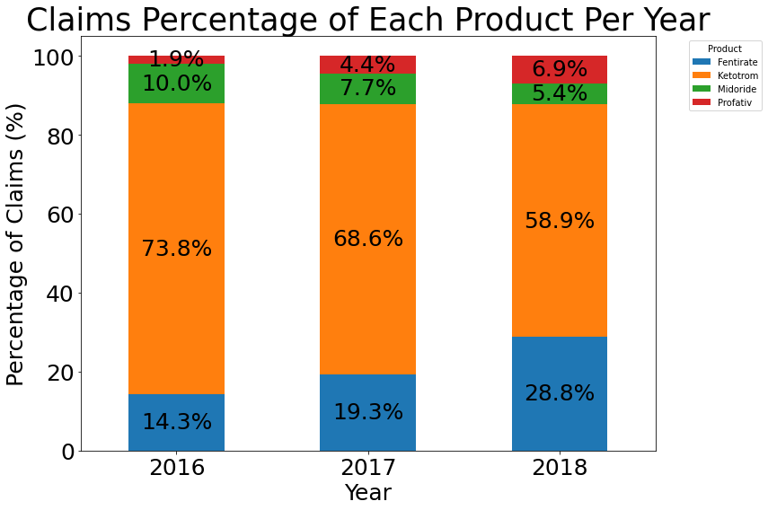
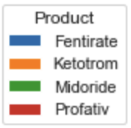
Decline in Claims Percentage for Midoride and Ketotrom
Observation: Ketotrom and Midoride show a consistent decline in claims percentage and number of patients over the years.
6

Slide 7
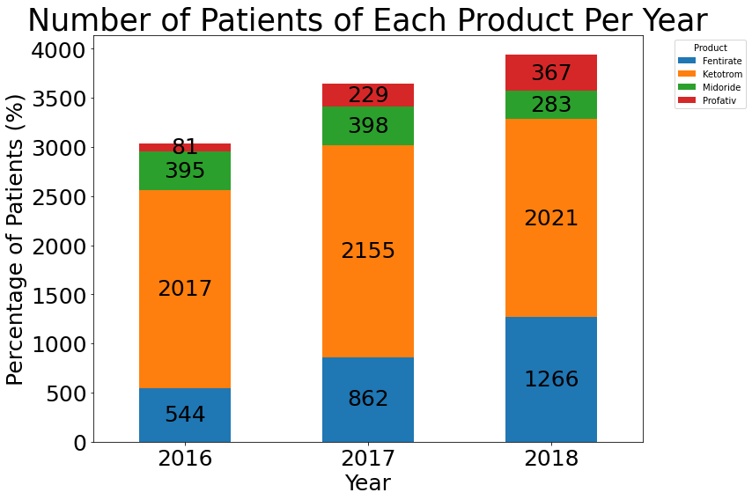
Rising Patient Numbers for Fentirate and Profativ
Fentirate and Profativ:
Shows a rapid increase in claims percentage
Recommendation:
Develop and Implement a Targeted Marketing Campaign Focused on Differentiation and Value Proposition of Midoride
7

Slide 8
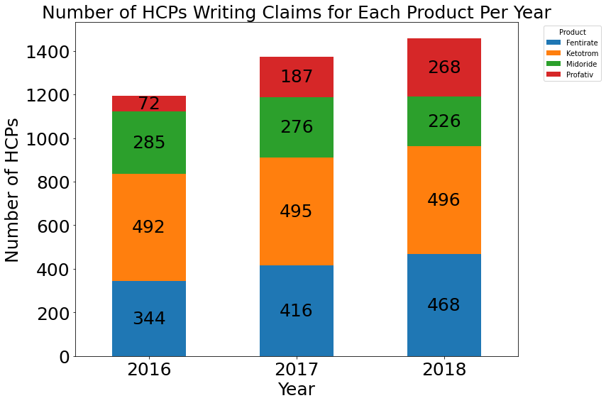
Profativ's Rising Popularity: More HCPs Prescribing Year on Year
Observations:
Ketotrom and Midoride: The number of HCPs writing claims for Midoride indicates good initial acceptance. But Both show a decline in HCPs support over the years.
Fentirate and Profativ: Have consistent growth in HCPs support, surpassing competitors.
Recommendation: Initiate a Comprehensive HCP Engagement and Education Program focused on Midoride
8

Slide 9
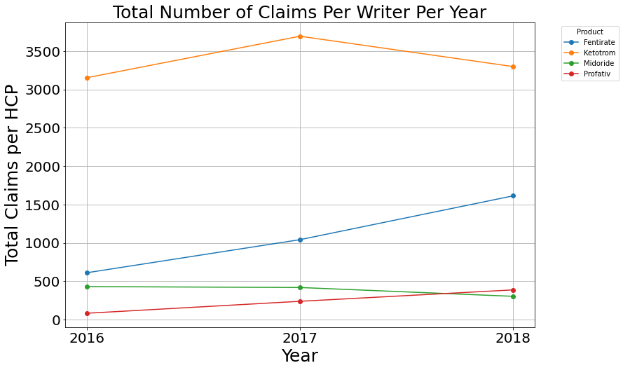
Fentirate's Rise in claims numbers Impacting Midoride's Market Position
Observations: > Ketotrom and Midoride shows a decline from 2017
> Fentirate and Profativ start to show good improvement from 2017
Recommendation: Establish a feedback loop on Midoride with HCPs
9

Slide 10
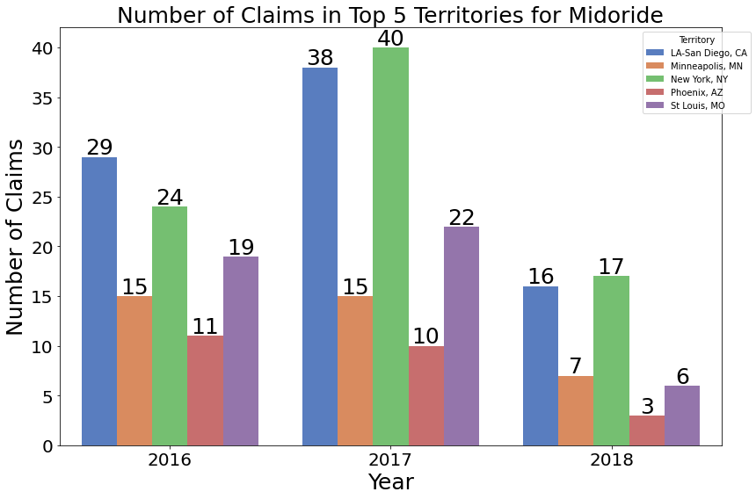
Midoride Fails to Hold its Market in Key Territories
Observation:
There is a notable decrease in the number of claims for Midoride from 2017 to 2018 across all top 5 territories. The most significant drops are in St. Louis, MO, and Phoenix, AZ, followed by LA-San Diego.
10

Slide 11
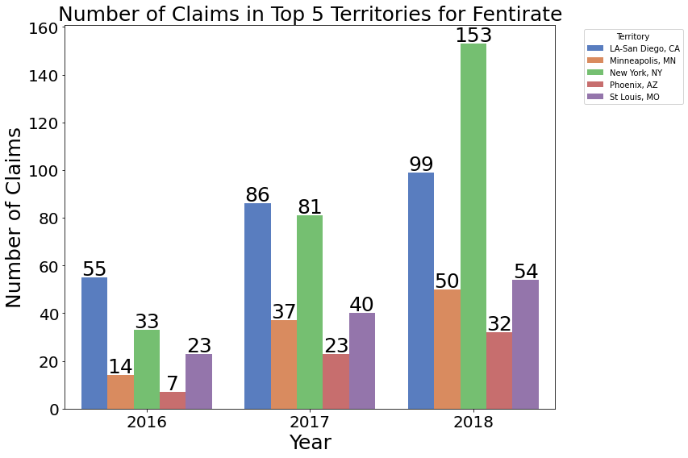
Fentirate Captures Midoride’s Market in Key Territories
Observation:
There’s growth in claims in all the top 5 territories during the same period, with substantial increases particularly in New York, NY, and LA-San Diego, CA.
Recommendation:
Differential Pricing Strategy for Midoride in High-Value Territories
11

Slide 12
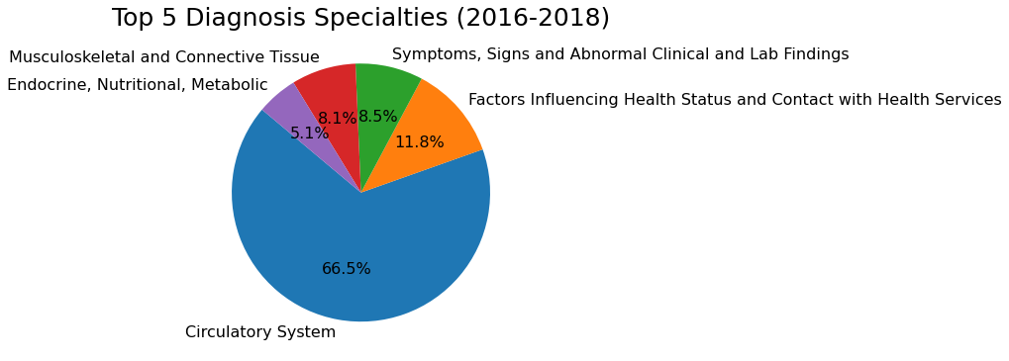
Observation: Circulatory System has significantly higher percentage in the top Diagnosis specialities.
Health status-related factors and general symptoms also represent significant portions. Smaller segments are associated with musculoskeletal, connective tissue, and endocrine/metabolic conditions.
Recommendation:
Educational materials & HCP-targeted resources for Musculoskeletal, Circulatory, Endocrine fields.
12

Slide 13
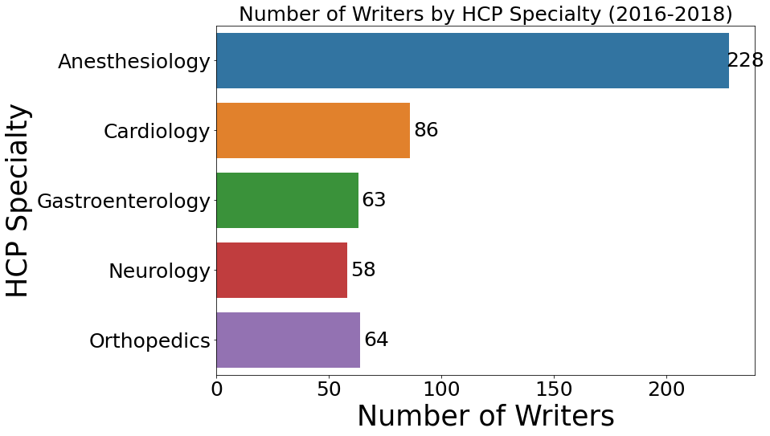
Anesthesiology Leads HCP Specialty in Prescriber Count
Observations:
The majority of claims are associated with Circulatory System disorders
HCP Specialties: Anesthesiologists are the primary prescribers.
Recommendation:
Implement a specialized Key Opinion Leader engagement strategy tailored to anesthesiologists to influence their prescribing decisions in favor of Midoride, emphasizing its efficacy in pain management
13

Slide 14
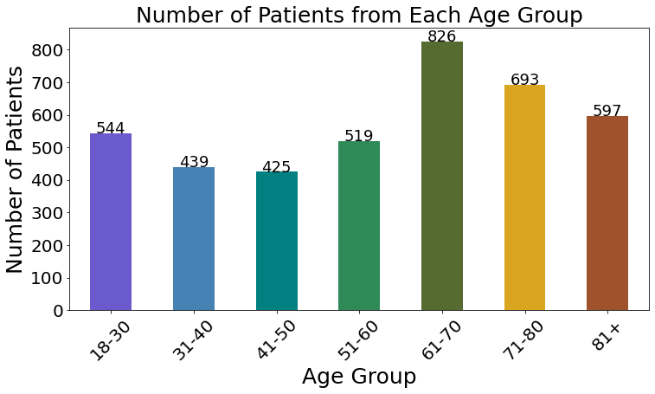
Senior Age Group Leads in Patient Numbers
The senior age group: 61-80+ shows top percentage of claims.
The 18-30 age group has a higher percentage of claims than middle-aged groups, which could imply an untapped or growing market segment for anesthesia drugs.
14

Slide 15
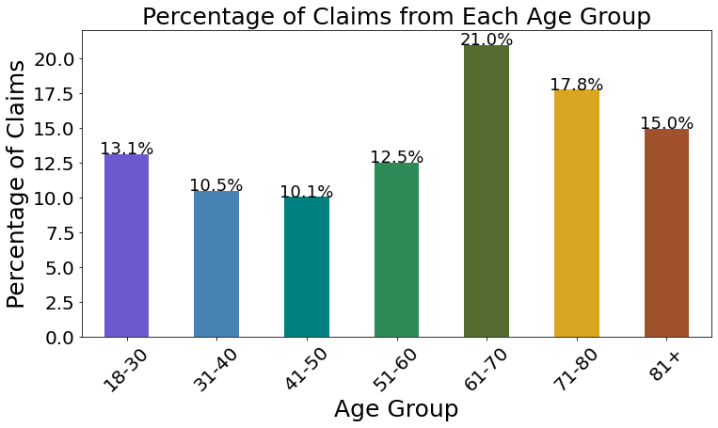
Senior Age Group also leading in Claims Percentage
Recommendation: Implement a comprehensive advertising campaign targeting seniors through print media, direct mail, TV and radio ads, emphasizing clear messaging and relatable content to effectively reach this demographic and promote your product or service.
15

Slide 16
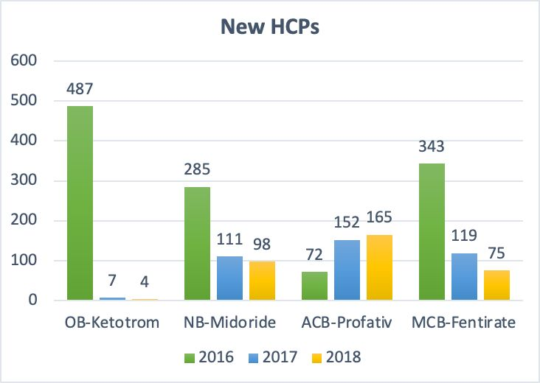
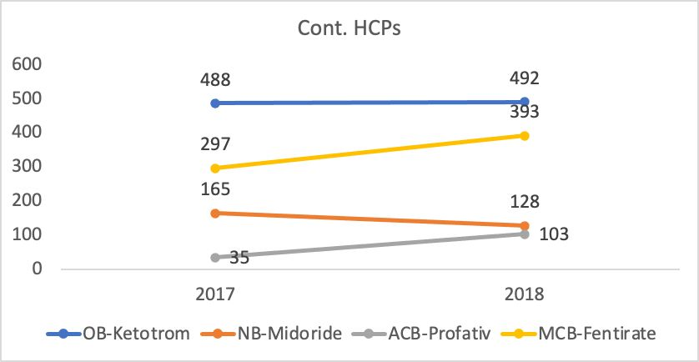
Fentirate and Profativ attracting new and Continuing HCP writers
New HCP writers per product (2016-2018)
Continuing HCP writers per product (2016-2018)
Recommendation:
Continuously share updated clinical data, research findings, and real-world evidence demonstrating Midoride’s effectiveness with the HCPs.
16

Slide 17
Strategies for Market Share Growth
Develop Targeted Marketing Campaign:
Focus on Differentiation and Value Proposition
Emphasize Unique Selling Points
Implement HCP Engagement and Education Program:
Counter Growing Preference for Fentirate
Evidence-Based Marketing Materials
Feedback Mechanism
Regional Pricing Strategy:
Leverage Cost-Effectiveness as Competitive Advantage
Continuously Monitor and Adapt
Specialized KOL Engagement:
Target Anesthesiologists
Collaboration and Education
Track Impact with Data Analytics
Targeted Advertising for Seniors:
Multi-Channel Approach
Print, Direct Mail, TV, Radio, Online Ads
Empathetic and Clear Messaging
Partnering with Healthcare Professionals
17

Slide 18
Data Exploration Opportunities
Limited information on insurance coverage differences among the 4 products
The difference marketing strategies of Profativ and Midoride (Sales force deployment, Digital Marketing, etc).
18

Slide 19
19

